Slide 1
Cryptography and Network Security
Seventh Edition
by William Stallings

Slide 2
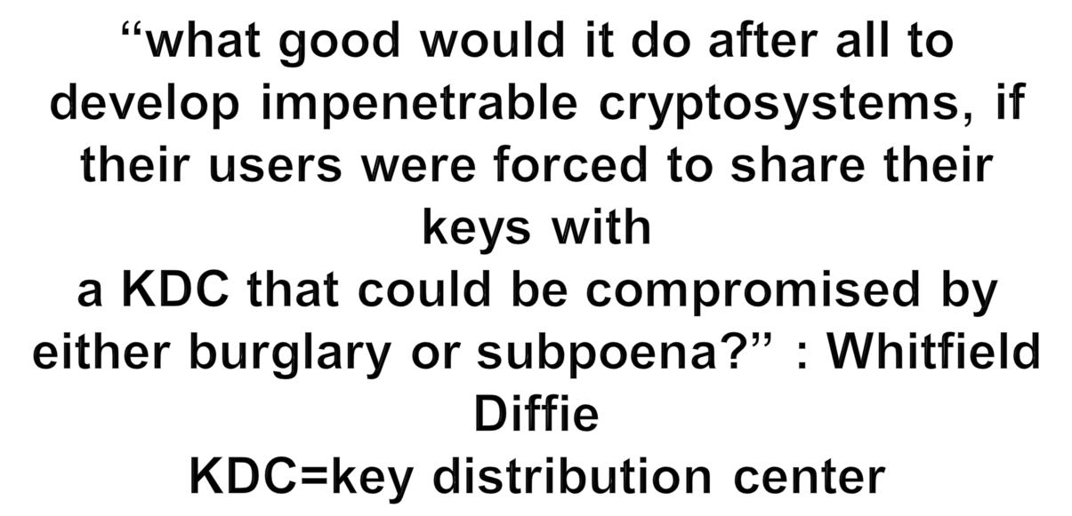
Chapter 9 – Public Key Cryptography and RSA

Slide 3
Private-Key Cryptography
traditional private/secret/single key cryptography uses one key
shared by both sender and receiver
if this key is disclosed communications are compromised
also is symmetric, parties are equal
hence does not protect sender from receiver forging a message & claiming is sent by sender
Notes:
So far all the cryptosystems discussed have been private/secret/single key (symmetric) systems. All classical, and modern block and stream ciphers are of this form.

Slide 4
Public-Key Cryptography
probably most significant advance in the 3000 year history of cryptography
uses two keys – a public & a private key
asymmetric since parties are not equal
uses clever application of number theoretic concepts to function
complements rather than replaces private key crypto
Notes:
Will now discuss the radically different public key systems, in which two keys are used. Anyone knowing the public key can encrypt messages or verify signatures, but cannot decrypt messages or create signatures, counter-intuitive though this may seem. It works by the clever use of number theory problems that are easy one way but hard the other. Note that public key schemes are neither more secure than private key (security depends on the key size for both), nor do they replace private key schemes (they are too slow to do so), rather they complement them.

Slide 5
Public-Key Cryptography
public-key/two-key/asymmetric cryptography involves the use of two keys:
  a public-key, which may be known by anybody, and can be used to encrypt messages, and verify signatures
  a private-key, known only to the recipient, used to decrypt messages, and sign (create) signatures
is asymmetric because
  those who encrypt messages or verify signatures cannot decrypt messages or create signatures

Slide 6
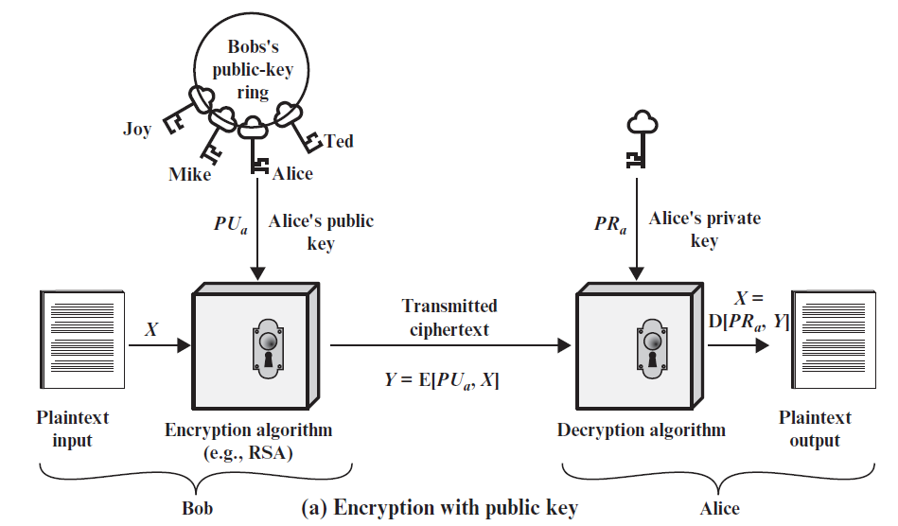
Public-Key Cryptography
Notes:
Stallings Fig 9.1

Slide 7
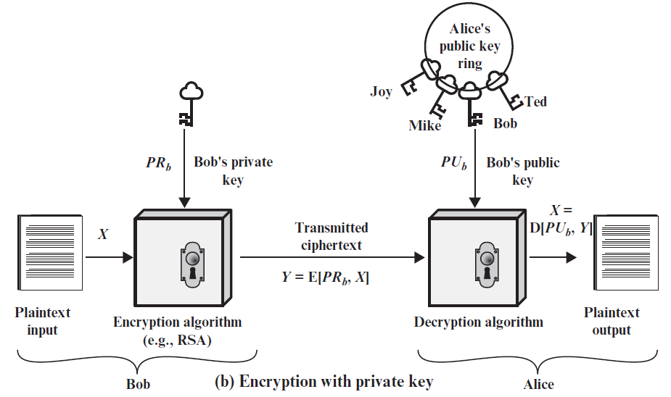
Public-Key Cryptography

Slide 8
Why Public-Key Cryptography?
developed to address two key issues:
  key distribution – how to have secure communications in general without having to trust a KDC with your key
  digital signatures – how to verify a message comes intact from the claimed sender
public invention due to Whitfield Diffie & Martin Hellman at Stanford Uni in 1976
  known earlier in classified community
Notes:
The idea of public key schemes, and the first practical scheme, which was for key distribution only, was published in 1977 by Diffie & Hellman. The concept had been previously described in a classified report in 1970 by James Ellis (UK CESG) - and subsequently declassified in 1987. See History of Non-secret Encryption (at CESG). Its interesting to note that they discovered RSA first, then Diffie-Hellman, opposite to the order of public discovery!

Slide 9
Public-Key Characteristics
Public-Key algorithms rely on two keys with the characteristics that it is:
  computationally infeasible to find decryption key knowing only algorithm & encryption key
  computationally easy to en/decrypt messages when the relevant (en/decrypt) key is known
  either of the two related keys can be used for encryption, with the other used for decryption (in some schemes)
Notes:
Public key schemes utilise problems that are easy (P type) one way but hard (NP type) the other way, eg exponentiation vs logs, multiplication vs factoring. Consider the following analogy using padlocked boxes: traditional schemes involve the sender putting a message in a box and locking it, sending that to the receiver, and somehow securely also sending them the key to unlock the box. The radical advance in public key schemes was to turn this around, the receiver sends an unlocked box to the sender, who puts the message in the box and locks it (easy - and having locked it cannot get at the message), and sends the locked box to the receiver who can unlock it (also easy), having the key. An attacker would have to pick the lock on the box (hard).

Slide 10
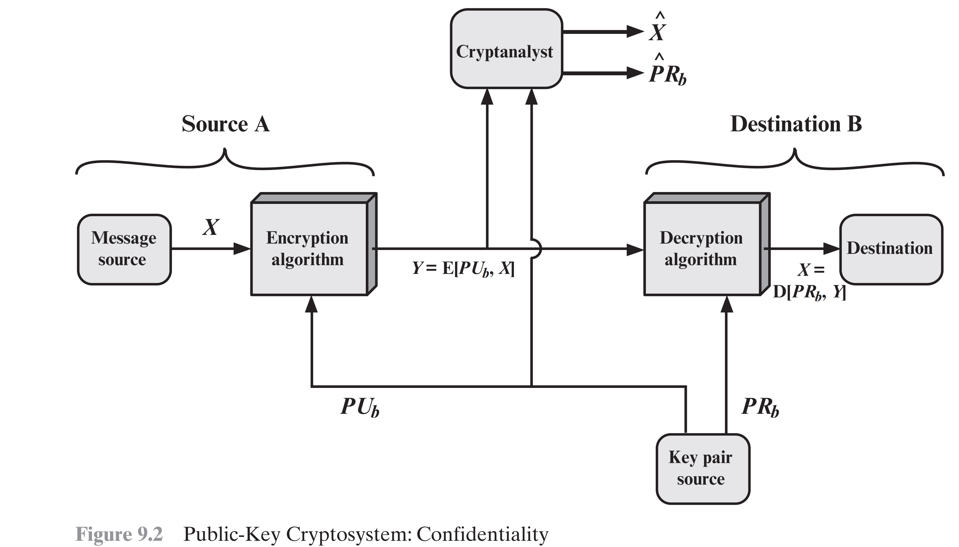

Slide 11
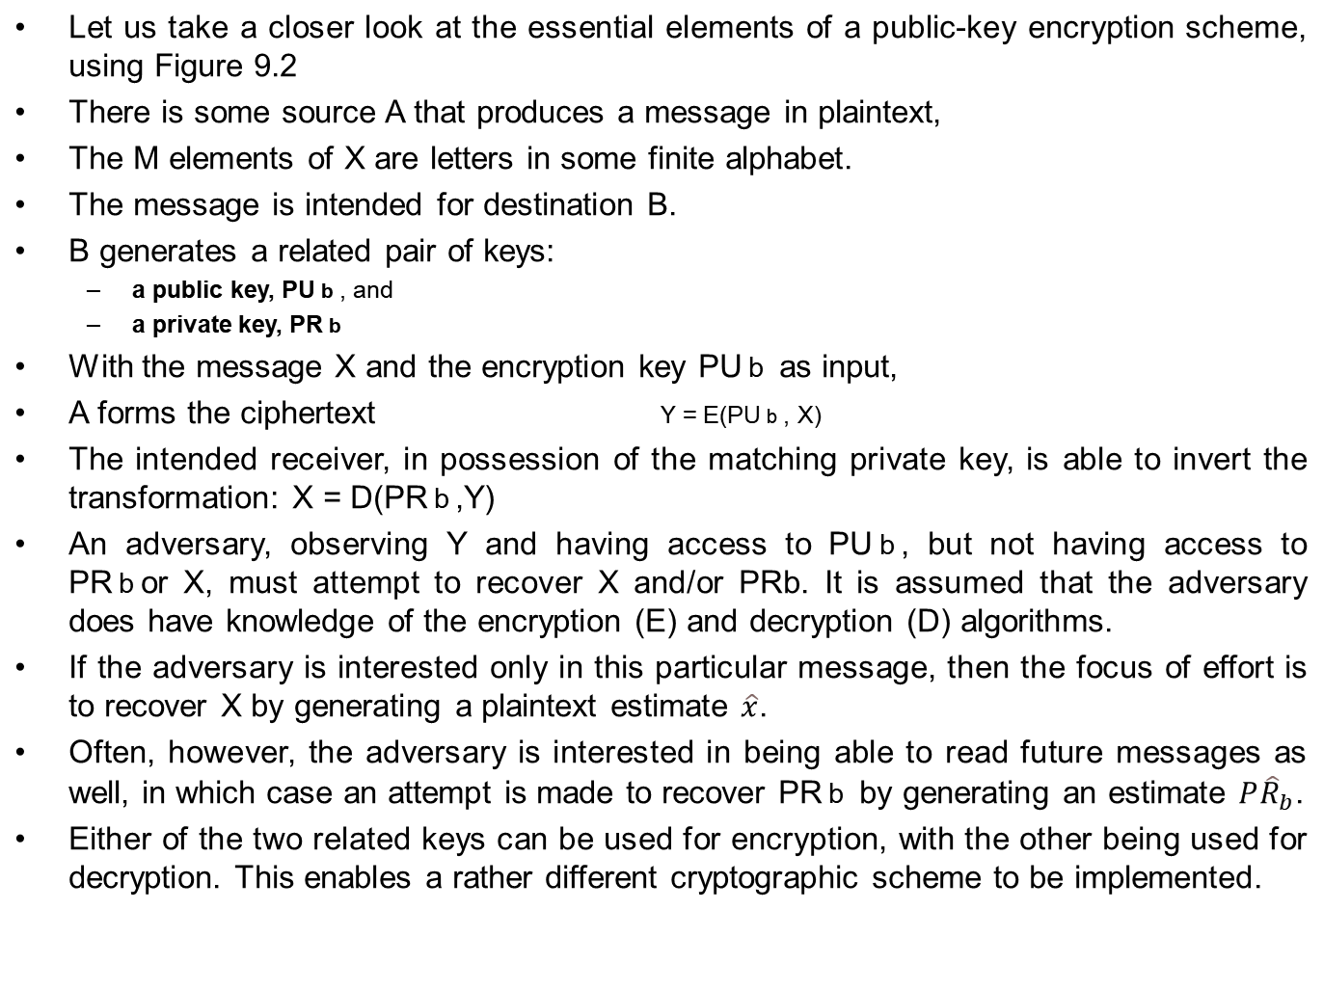
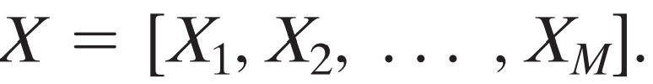


Slide 12
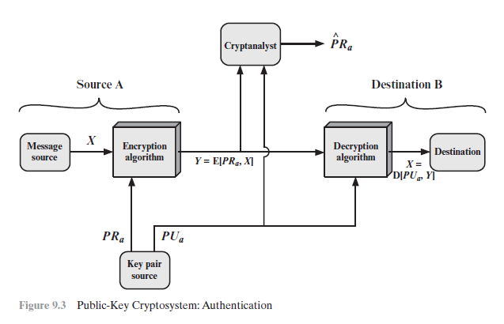

Slide 13
Figures 9.1b and 9.3 show the use of public-key encryption to provide authentication:
        Y = E(PRa,X)
        X = D(PUa,Y)
In this case, A prepares a message to B and encrypts it using A’s private key before transmitting it.
B can decrypt the message using A’s public key.
Only A(as A’s private key is used) could have prepared the message.
Therefore, the entire encrypted message serves as a digital signature.
In addition, it is impossible to alter the message without access to A’s private key.

Slide 14
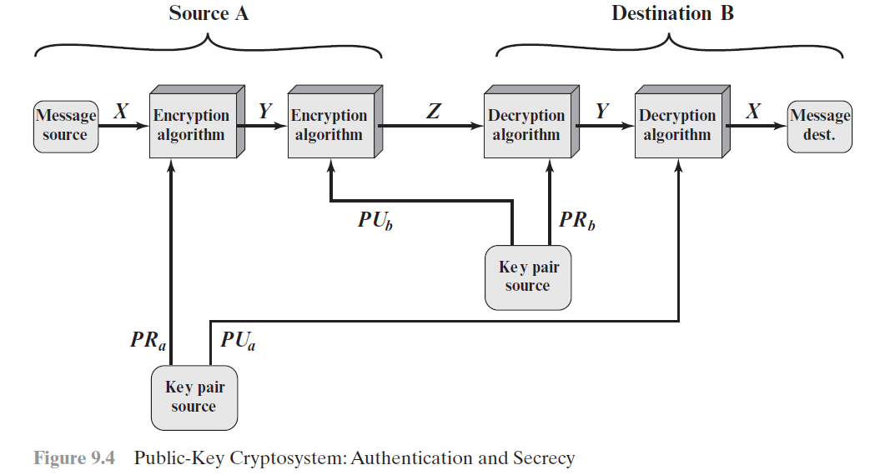

Slide 15
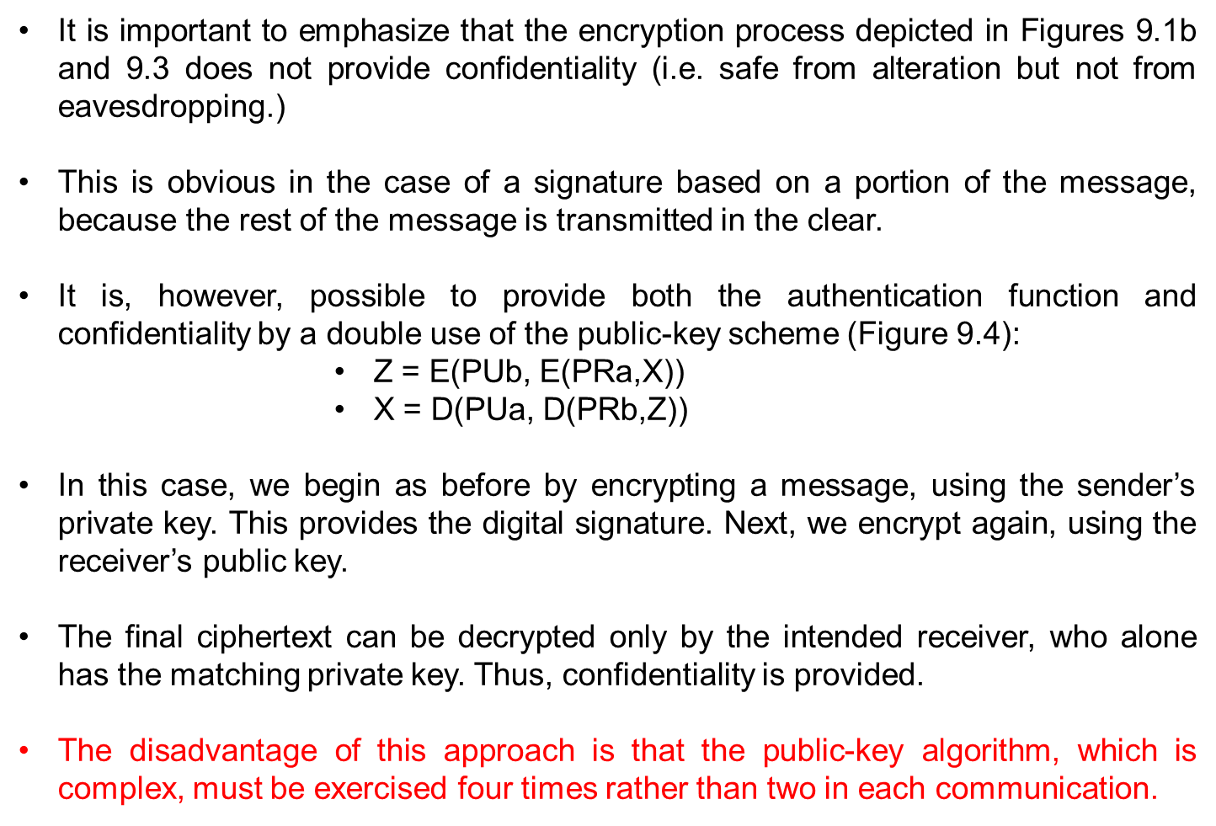

Slide 16
Public-Key Applications
Public-key systems are characterized by the use of a cryptographic algorithm with two keys, one held private and one available publicly. Depending on the application, the sender uses either the sender’s private key or the receiver’s public key, or both, to perform some type of cryptographic function.
can classify uses into 3 categories:
  Encryption / decryption(provide secrecy / confidentiality)
  digital signatures (provide authentication)
  key exchange (of session keys valid for some specific time)
some algorithms are suitable for all uses, others are specific to one

Slide 17
Requirements for Public-Key Cryptography(by Diffie and Hellman)
It is computationally easy for a party B to generate a key pair (public key PUb, private key PRb).
It is computationally easy for a sender A, knowing the public key and the message to be encrypted, M, to generate the corresponding ciphertext:
        C = E(PUb, M)
It is computationally easy for the receiver B to decrypt the resulting ciphertext using the private key to recover the original message:
      M = D(PRb, C) = D[PRb, E(PUb, M)]

Slide 18
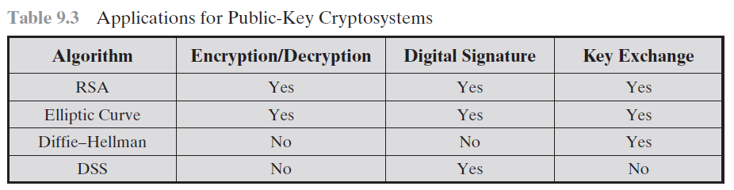
It is computationally infeasible for an adversary, knowing the public key, PUb, to determine the private key, PRb.
It is computationally infeasible for an adversary, knowing the public key, PUb, and a ciphertext, C, to recover the original message, M.
The two keys can be applied in either order (useful, not necessary)

Slide 19
Security of Public Key Schemes
like private key schemes brute force exhaustive search attack is always theoretically possible
but keys used are too large (>512bits)
security relies on a large enough difference in difficulty between easy (en/decrypt) and hard (cryptanalyse) problems
more generally the hard problem is known, its just made too hard to do in practise
requires the use of very large numbers
hence is slow compared to private key schemes
Notes:
Public key schemes are no more or less secure than private key schemes - in both cases the size of the key determines the security. Note also that you can't compare key sizes - a 64-bit private key scheme has very roughly similar security to a 512-bit RSA - both could be broken given sufficient resources. But with public key schemes at least there's usually a firmer theoretical basis for determining the security since its based on well-known and well studied number theory problems.

Slide 20
RSA
by Rivest, Shamir & Adleman of MIT in 1977
best known & widely used public-key scheme
based on exponentiation in a finite (Galois) field over integers modulo a prime
uses large integers (eg. 1024 bits)
security due to cost of factoring large numbers
Notes:
RSA is the best known, and by far the most widely used general public key encryption algorithm.

Slide 21
RSA Key Setup
select two random large primes p, q
compute N = p.q
Compute ø(N)=(p-1)(q-1)
select randomly the encryption key e
where 1 < e < ø(N), gcd(e,ø(N)) = 1
find decryption key d
e.d = 1 mod ø(N) and 0 ≤ d ≤ N
public encryption key: PU = {e,N}
private decryption key: PR = {d,N}
Notes:
This key setup is done once (rarely) when a user establishes (or replaces) their public key. The exponent e is usually fairly small, just must be relatively prime to ø(N). Need to compute its inverse to find d. It is critically important that the private key KR={d,p,q} is kept secret, since if any part becomes known, the system can be broken. Note that different users will have different moduli N.

Slide 22
RSA Use
to encrypt a message M the sender:
  obtains public key of recipient PU={e,N}
  computes: C=Me mod N, where 0≤M<N
to decrypt the ciphertext C the owner:
  uses their private key PR={d,N}
  computes: M=C^{d} mod N
note that the message M must be smaller than the modulus N (block if needed)

Slide 23
RSA Example
Select primes: p=17 & q=11
Compute n = pq =17×11=187
Compute ø(n)=(p–1)(q-1)=16×10=160
Select e : gcd(e,160)=1; choose e=7
Determine d: d.e=1 mod 160 and d < 160 Value is d=23 since 23×7=161= 10×160+1
Publish public key PU={7,187}
Keep secret private key PR={23,187}
Notes:
Here walk through example using “trivial” sized numbers.
Selecting primes requires the use of primality tests.
Finding d as inverse of e mod ø(n) requires use of Inverse algorithm (see Ch4)

Slide 24
RSA Example cont
sample RSA encryption/decryption is:
given message M = 88 (nb. 88<187)
encryption:
  C = 88⁷ mod 187 = 11
decryption:
  M = 11²³ mod 187 = 88
Notes:
Rather than having to laborious repeatedly multiply, can use the "square and multiply" algorithm with modulo reductions to implement all exponentiations quickly and efficiently (see next).

